Slide 1
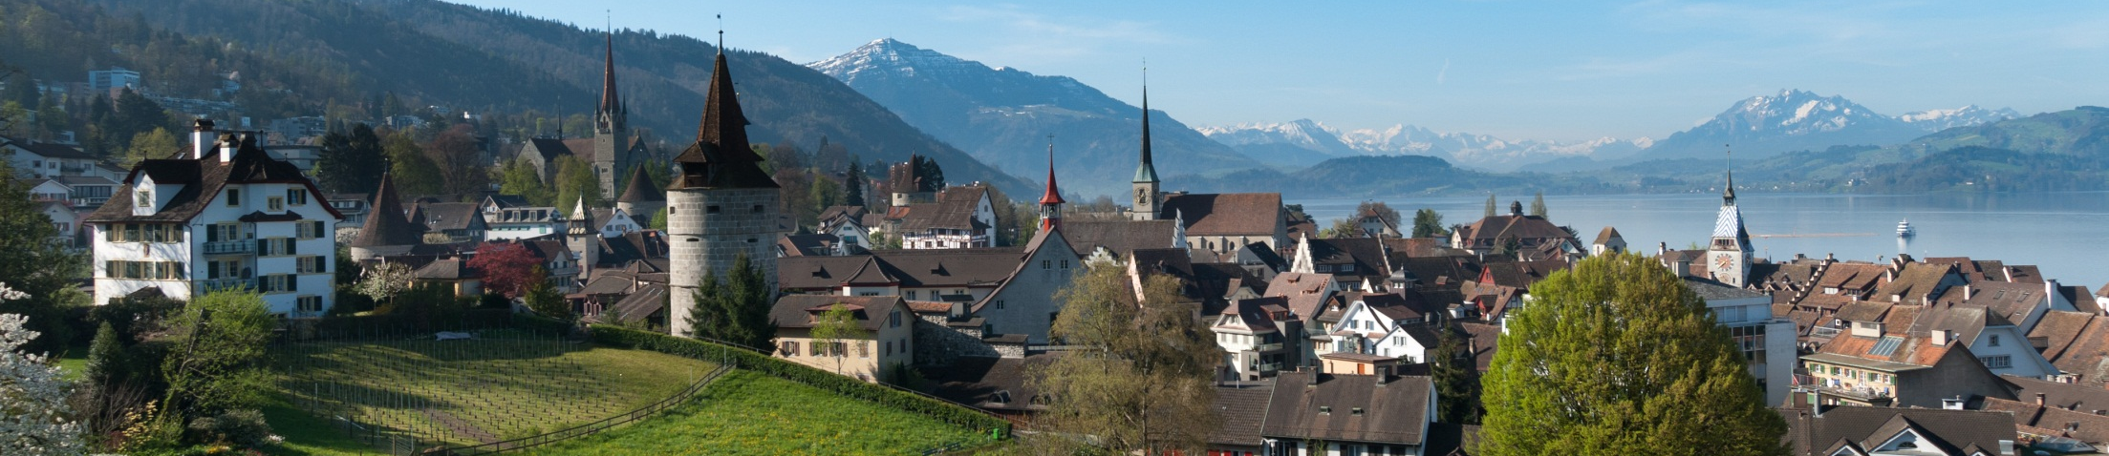
Stability and growth
For many decades about 75% conservative voters
Multiparty political system = long-standing tradition and stability
Long-term fiscal and tax policy (net equity / long-term decreasing tax rates)
Expansion of established and dynamic growth of new companies
Planning reliability and legal certainty

